Slide 1

B.Tech 6th Semester Minor project Presentation
Gesturesflow (Virtual Mouse)
Presented by:
NIRANJAN PAL (210305124158)
ANKIT SRIVASTAVA (210305124125)
DIVYAAJEET PARMAAR (210305124141)
ASHISH KUMAR (210305124143)
Supervisors:
AKASH PATIL
(ASST.PROF, PIT)
PARUL INSTITUTE OF TECHNOLOGY, PARUL UNIVERSITY
NAME OF THE INSTITUTE, PARUL UNIVERSITY

Slide 2
Abstract
New technologies are making it possible to control computers without touching them.
In this presentation, we'll look at how hand movements can replace using a mouse or keyboard in virtual reality. Our project aims to see if we can make this idea work using just a camera and some modules in Python like OpenCV, mediapipe, pyautogui.
While this idea is exciting, there are challenges like making sure the computer understands our hand movements in different environments. But if we can figure it out, it could change how we can interact with computers
NAME OF THE INSTITUTE, PARUL UNIVERSITY
NAME OF THE INSTITUTE, PARUL UNIVERSITY

Slide 3
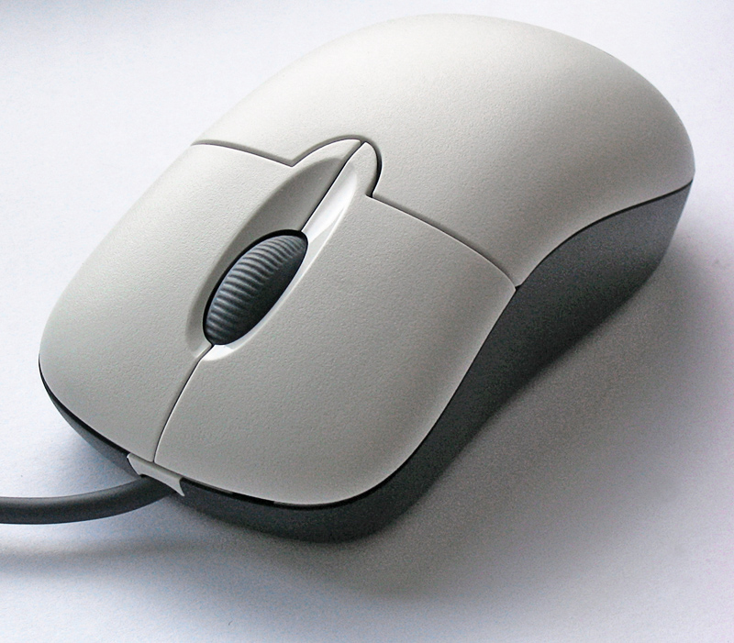
Introduction
In today's rapidly evolving technological landscape, traditional mouse control methods are becoming increasingly outdated.
NAME OF THE INSTITUTE, PARUL UNIVERSITY
NAME OF THE INSTITUTE, PARUL UNIVERSITY

Slide 4
Introduction
Virtual mouse technologies offer a modern and innovative alternative the way users interact with their devices.
The focus of our project is to develop an interactive virtual mouse control system.
This system will be driven by dynamic hand gestures, providing users with a seamless and intuitive control experience.
NAME OF THE INSTITUTE, PARUL UNIVERSITY
NAME OF THE INSTITUTE, PARUL UNIVERSITY

Slide 5
Problem Statement
Traditional methods of interaction, primarily reliant on physical mouse devices.
It pose challenges in terms of :
- Accessibility
- Usability
- Hygiene

Slide 6
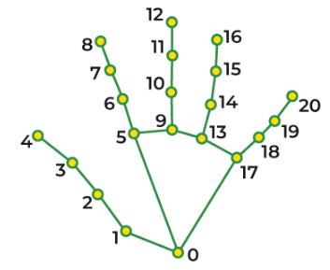
Proposed Methodology
The gesture-based virtual mouse system uses the transformational approach to translate the coordinates of the fingertip from the camera screen to the full-screen computer window so that the mouse can be used.
Modules Used:
  - OpenCV
  - mediapipe
  - pyautogui

Slide 7
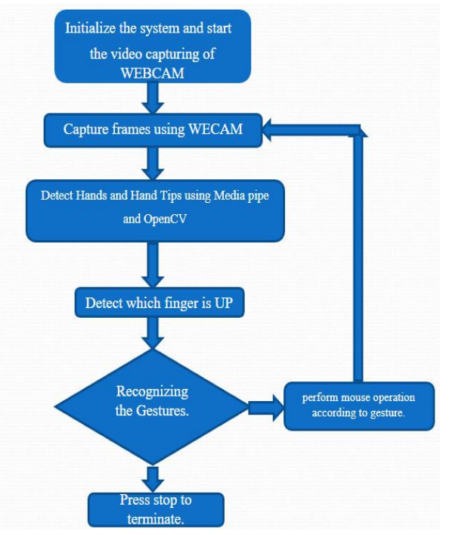
Use case diagram/ER diagram/Flow diagram

Slide 8

Hardware and Software
Software Requirements
Operating System: Compatible with Windows, macOS, or Linux distributions.
Python: Version 3.8.5
Python Libraries:
- OpenCV
- mediapipe
- pyautogui
- Numpy
Anaconda (allows you to create separate environments, each containing their own files, packages, and package dependencies).

Slide 9
Hardware and Software
Hardware Requirements:
Computer with a minimum of 2 GHz processor (multi-core recommended for better performance).
Minimum of 4 GB RAM (8 GB or more recommended for smoother operation).
Webcam or camera for capturing live video frames.
Standard input devices such as a keyboard and mouse for system control during development.

Slide 10
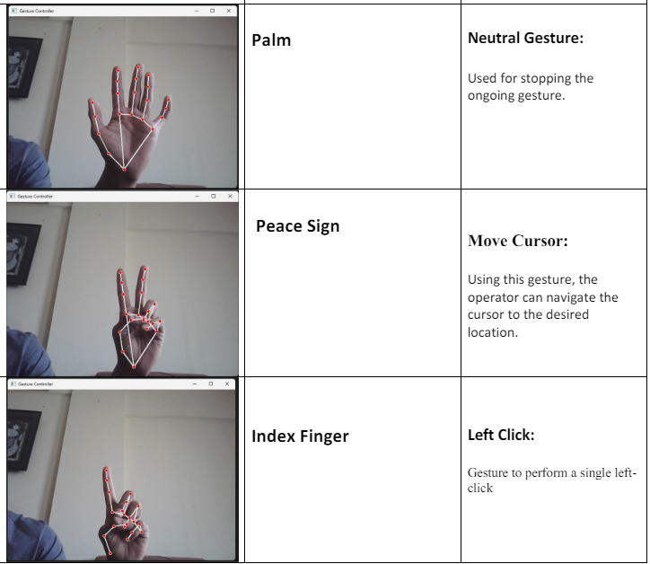
Excepted Outcome of the Project

Slide 11
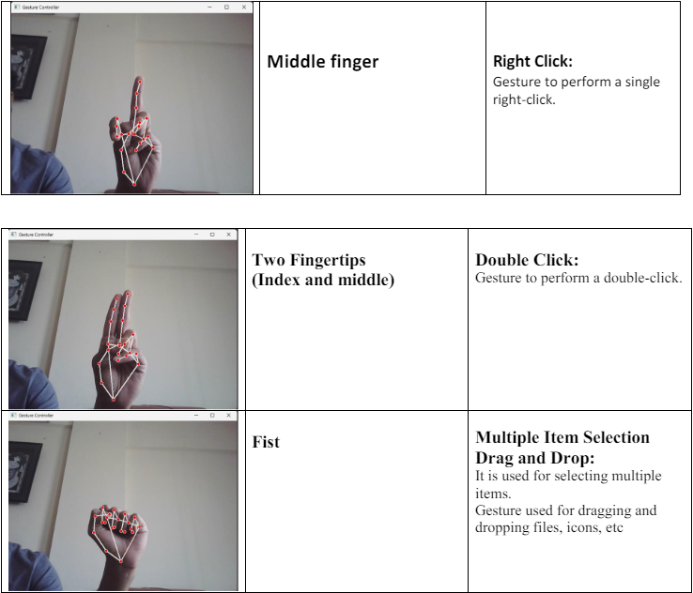
Excepted Outcome of the Project

Slide 12
Conclusion and Future Work
Conclusion:
An effective and user-friendly technology that enables numerous mouse activities including clicking, dragging, and scrolling by simple hand movements is a virtual mouse operated by hand gestures.
Convenience and Accessibility: Virtual Mouse Control System enables mouse activities through hand gestures, benefiting users, especially those with mobility or disability challenges.

Slide 13
Conclusion and Future Work
Future work:
Advanced computer vision for improved accuracy.
Machine learning for better gesture recognition.
Incorporating other input devices like voice or eye-tracking for even more accessibility and flexibility.
Potential Future:
  -VR/AR Tech
  -Gaming
  -Entertainment(eg-Apple Vision Pro)

Slide 14
References
[1] Singhal P, A. Haria, A. Subramanian, N. Asokkumar, S. Poddar, and J. S. Nayak, “Hand Gesture Recognition for Human Computer Interaction,” in Procedia Computer Science, Elsevier B.V., 2017, pp. 367–374. doi: 10.1016/j.procs.2017.09.092.
[2] V. Sharma, H. Kolivand, D. Al-Jumeily Obe, M. Jayabalan, S. Asadianfam, and D. Al-Jumeily, “Gesture Recognition Techniques mobile multimedia learning for engineering education View project Health Care (Cervical Cancer) Data Screening View project Gesture Recognition Techniques.” [Online]. Available: https://www.researchgate.net/publication/368292413
[3] T. Grzejszczak, R. Molle, and R. Roth, “Tracking of dynamic gesture fingertips position in video sequence,” Archives of Control Sciences, vol. 30, no. 1, pp. 101–122, 2020, doi: 10.24425/acs.2020.132587

